Slide 1
Digital Engineering 1
Lecture 7

Slide 2
Combinational Circuits
Output is only dependent on the current input.
Need not know past history of values
Basic gates like AND, OR, NOT, NAND, NOR, XOR, XNOR are all combinational

Slide 3
Combinational Logic Design
Problem Analysis
Representation
Implementation
Notes:
Understand the Problem:
input/output behavior
identify the inputs, outputs, and control signals
draw a top level block diagram if necessary
Formulate in a Standard Representation:
truth tables or Boolean equations
Choose an Implementation:
discrete logic gates
programmable logic devices: PAL, PLA, ROM, FPGA
Apply the Design Procedure:
follow the representation → minimization → implementation algorithm mechanically
simulate your circuit before implementing it on actual devices
implement it on actual devices and verify your implementation.

Slide 4
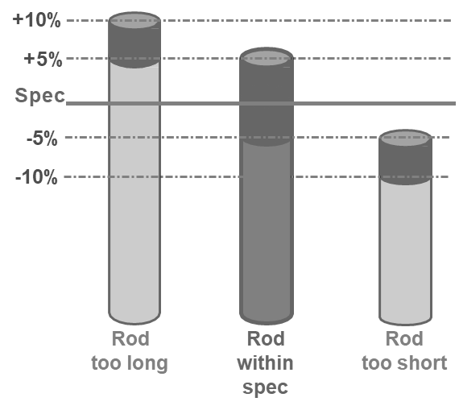
Example: Process Line Control
Design a controller to select right length metal rods out of rods of varying length (±10%) traveling one at a time on a conveyor belt. Rods that are within spec. (±5%) remain on the belt. Rods that are too short or too long are discarded by mechanical arm(s).

Slide 5
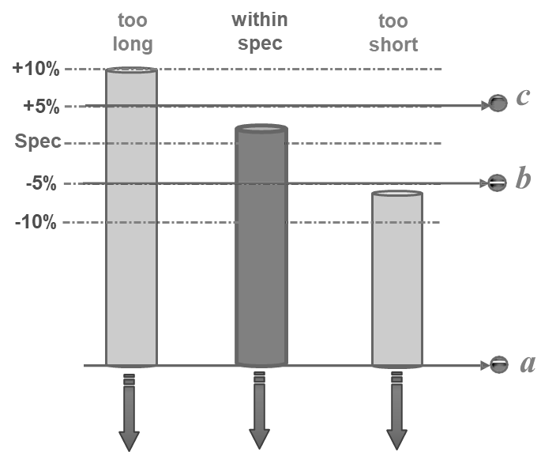
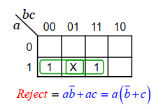
a | b | c | Reject
0 | 0 | 0 | 0
0 | 0 | 1 | 0
0 | 1 | 0 | 0
0 | 1 | 1 | 0
1 | 0 | 0 | 1
1 | 0 | 1 | X
1 | 1 | 0 | 0
1 | 1 | 1 | 1
too short
in spec
too long

Slide 6
Building Blocks for Combinational Circuits
Decoders
Encoders
Multiplexers
Demultiplexers

Slide 7
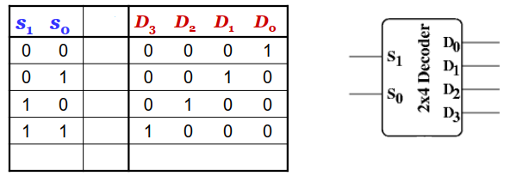
Decoders
Binary-to-Decimal decoder: n inputs, 2^{n} outputs (n x 2^{n}decoder). Some decoders have enable inputs.
Each output represents a minterm of an n-variable function.
The output that corresponds to the minterm that appears on the inputs is asserted (active low or high depending upon the device), all other outputs are inactive.

Slide 8
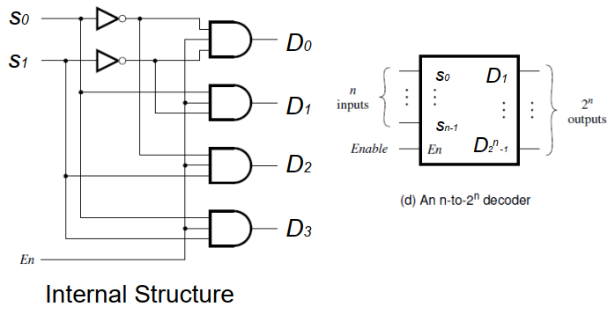
Decoder

Slide 9
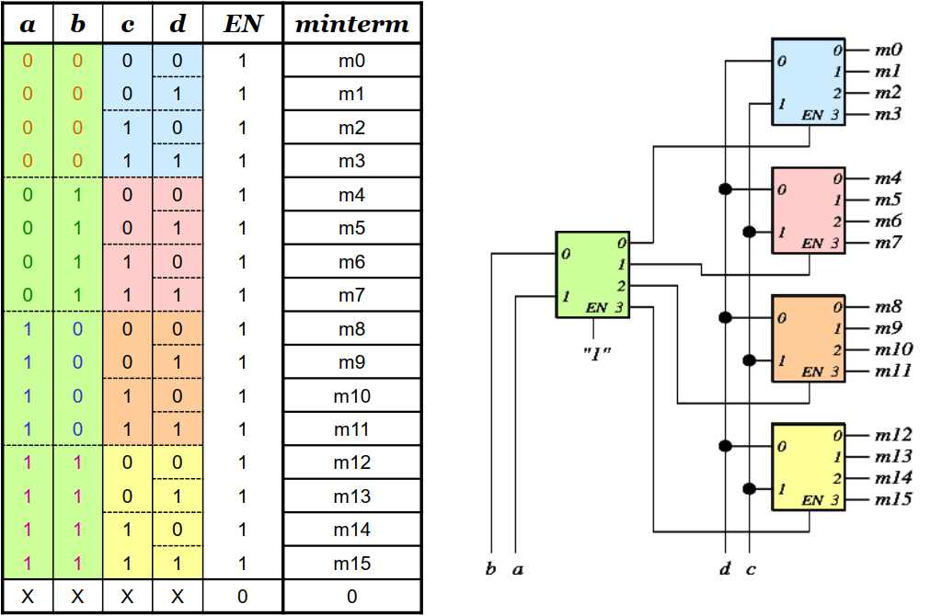
Build a 4x16 decoder using 2x4 decoders (decoder tree)

Slide 10
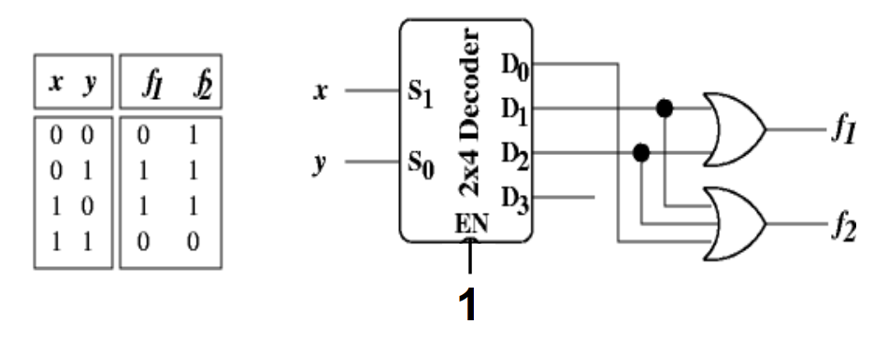
Implementing Logic using Decoders
Decoders can be used to implement logic functions as follows:

Slide 11
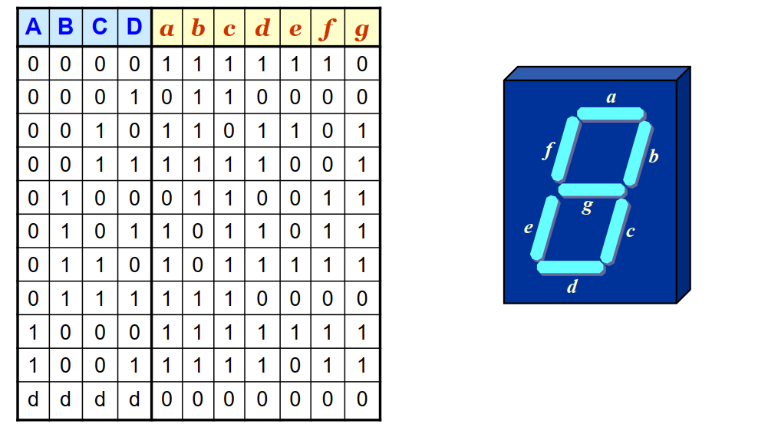
BCD-7 Segment Decoder

Slide 12
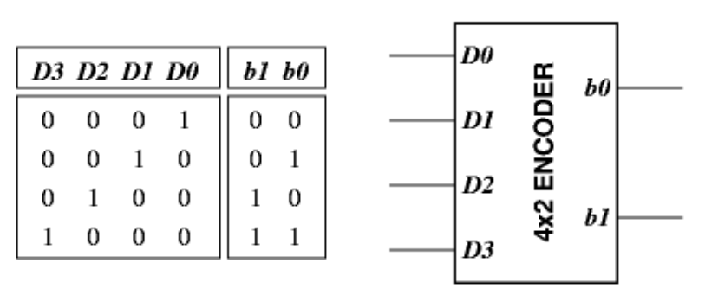
Encoders
Encoder is opposite of decoder. Its output code has fewer bits than the input code.
Binary Encoder: Input: 1-out-of-2^{n} code (decimal input). Output: n-bit binary code.

Slide 13
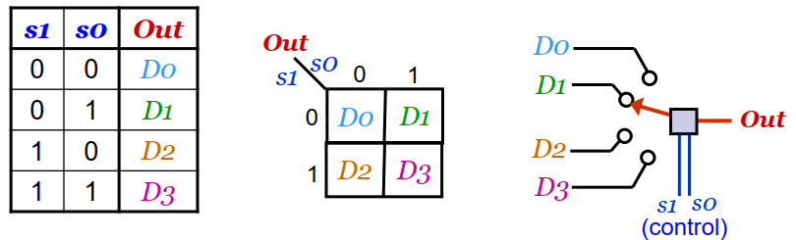
Multiplexers
Multiplexing means transmitting a large number of information units over a smaller number of channels or lines.
A digital multiplexer (MUX) selects binary information from one of many input lines and directs it to a single output line.
Data selector (2^{n}:1 MUX).
Inputs: 2^{n} data inputs, n select lines.
Output: 1 data output line.

Slide 14
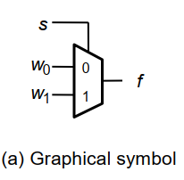
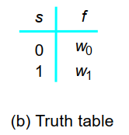
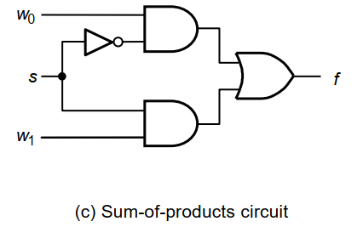
2:1 Mux

Slide 15
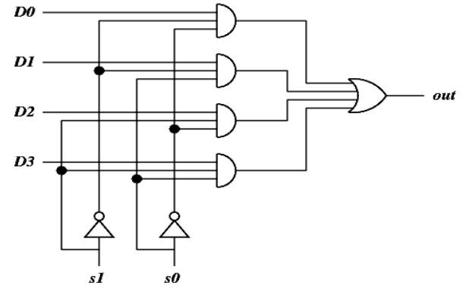
Internal Structure of a 4:1 MUX
A 2^{n}:1 MUX needs 2^{n}, (n+1)-input AND gates for selection and a 2^{n}-input OR gate to generate the final output. ⇨ AND/OR logic structure

Slide 16
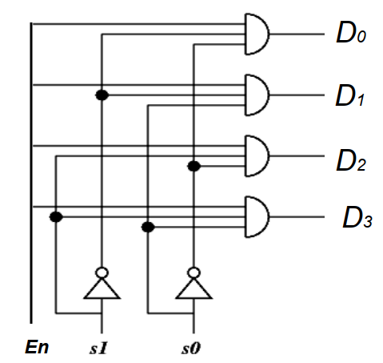
Closeness to Decoders
Connect all the input lines of the multiplexer together (to make enable) and remove the OR gate to give you a decoder

Slide 17

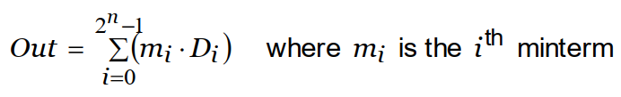
MUX Output Boolean Expression
2:1 MUX
4:1 MUX
General expression for 2^{n} : 1 MUX

Slide 18
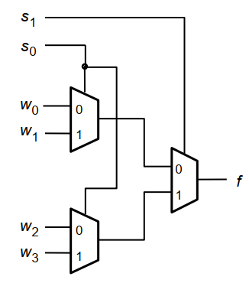
Using 2:1 Muxes to Build a 4:1 Mux

Slide 19
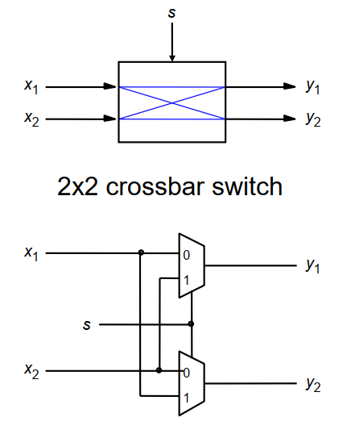
Practical Application of Multiplexers

Slide 20
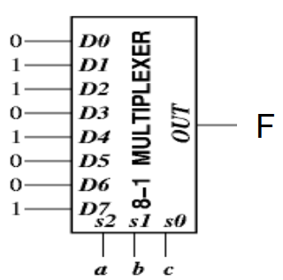

MUX Based Logic Design
MUXes are sometimes called hardware look-up tables.
To implement an n-variable function using a 2^{n}:1 MUX
Use a 2^{n}:1 MUX, connect n input variables to the n select lines
(in the correct MSB-LSB order).
Wire MUX input D_{i} to 1 if function includes minterm mi. All other
inputs are set to 0.
Example: Implement the function using a MUX of appropriate size.

Slide 21
MUX Based Logic
Advantages:
Easier to design combinational circuits.
Easier to debug circuits designed using multiplexers.
Disadvantages:
Multiplexers can become very large for a large number of inputs.
Good for small circuits.
Normally, any function with more than 4 variable is impractical for direct implementation (i.e., using a single large MUX)
Use tree of small MUXes or using a variable as MUX data input or Shannon’s Expansion Theorem for implementing large functions.

